Slide 1
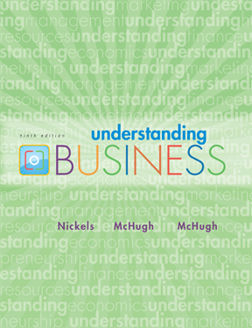


*
Chapter Five
*
Introduction to Business (BUS101)
Chapter 5: How to Form a Business
Nusrat Hafiz (NHF)
Lecturer, BRAC University

Slide 2

LEARNING OBJECTIVES
*
*
Forms of ownership
- Sole Proprietorship
- Partnership
- Corporation
Corporate Expansion
- Merger & Acquisition
-Franchising
5-2
Notes:
See Learning Goal 1: Compare the advantages and disadvantages of sole proprietorships.

Slide 3

OWNERSHIP FORMS
*
Basic Forms of Business Ownership
*
LG1
Sole Proprietorship
Partnership
Corporation
5-3
Notes:
See Learning Goal 1: Compare the advantages and disadvantages of sole proprietorships.

Slide 4

SOLE PROPRIETORSHIP
*
Sole Proprietorships
Key Features:
-It is a business owned, and usually managed, by one person.
-It has no legal distinction between the owner and the business entity.
-It has Unlimited Liability (debts or damages incurred by the business are not capped).
*
LG1
5-4
Notes:
See Learning Goal 1: Compare the advantages and disadvantages of sole proprietorships.
This slide helps students understand why sole proprietorships account for the largest number of businesses in the United States.

Slide 5
SOLE PROPRIETORSHIP
*
Sole Proprietorships
Advantages | Disadvantages
Ease of starting and ending the business | Unlimited Liability
Being your own boss | Limited Financial Resources
Pride of ownership | Management difficulties
Leaving a legacy | Overwhelming time commitment
Retention of company profit | Few fringe benefits
No special taxes | Limited growth
 | Limited life span
*
LG1
5-5
Notes:
See Learning Goal 1: Compare the advantages and disadvantages of sole proprietorships.
This slide helps students understand why sole proprietorships account for the largest number of businesses in the United States.

Slide 6

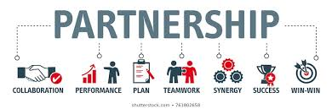
PARTNERSHIP
*
Partnership
Key Features:
-It is a formal arrangement by two or more parties agree to become co-owners of a business to manage and operate a business and share its profits.
-Partners choose over sole proprietorship because business responsibility can be shared and skills & experiences can be combined.
-Partnership firms may have one or general partners and one or more limited partners.
*
LG1
5-6
Notes:
See Learning Goal 1: Compare the advantages and disadvantages of sole proprietorships.
This slide helps students understand why sole proprietorships account for the largest number of businesses in the United States.

Slide 7
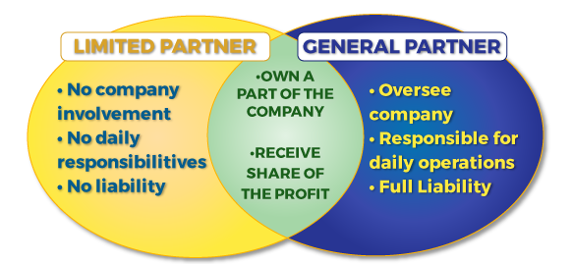
PARTNERSHIP
*
Partnership
Key Features:
-General partners in a partnership business oversee & run the business. They assume unlimited liability for business’s debts (being liable for all business debts if the business can not pay it’s liabilities).
-Limited Partners do not partake in managing the business. They invest money in the business but enjoy limited liability. They have limited liability to the amount of their investment. Hence, their personal assets are not at risk.
*
LG1
5-7
Notes:
See Learning Goal 1: Compare the advantages and disadvantages of sole proprietorships.
This slide helps students understand why sole proprietorships account for the largest number of businesses in the United States.

Slide 8
PARTNERSHIP
*
Sole Proprietorships
*
LG1
Advantages | Disadvantages
More financial resources | Unlimited Liability
Shared management and pooled skills and knowledge | Division of profits
Longer survival | Disagreement among partners
Leaving a legacy | Difficult to terminate
No special taxes
5-8
Notes:
See Learning Goal 1: Compare the advantages and disadvantages of sole proprietorships.
This slide helps students understand why sole proprietorships account for the largest number of businesses in the United States.

Slide 9
Individual Mini Activities
*
*
Give five (5) examples of sole proprietorship and five (5) examples of partnership business operating in Bangladesh.
5-9
Notes:
See Learning Goal 1: Compare the advantages and disadvantages of sole proprietorships.
This slide helps students understand why sole proprietorships account for the largest number of businesses in the United States.

Slide 10


CONVENTIONAL CORPORATIONS
*
Corporations
*
Key Features:
-It is a legal entity with authority to act and have liability apart from its owners.
-As it conducts business in its own name, it may own property, carry on business, enter into binding contracts, borrow money, incur liabilities, sue and be sued, and pay taxes.
-Incorporating business is one of the best ways to protect the owners’ personal assets. As a separate legal entity, a corporation is responsible for its own debts.
LG3
5-10
Notes:
See Learning Goal 3: Compare the advantages and disadvantages of corporations, and summarize the differences between C corporations, S corporations, and limited liability companies.

Slide 11
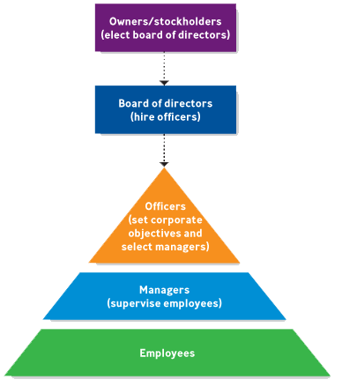
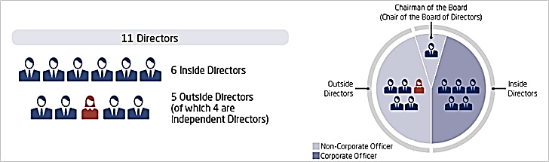
CONVENTIONAL CORPORATIONS
*
How do the owner affect management:
-Owners elect a board of directors (BOD).
-BOD recruits and remunerates the top officers (CEO, CFO, COO, CKO etc.).
-Through HRD, the officers select managers and employees.
*
5-11
Notes:
See Learning Goal 3: Compare the advantages and disadvantages of corporations, and summarize the differences between C corporations, S corporations, and limited liability companies.

Slide 12
CONVENTIONAL CORPORATIONS
*
Corporations
*
LG3
Advantages | Disadvantages
Limited liability | Initial cost
Ability to raise more money for investment | Extensive paperwork
Large size | Double taxation
Perpetual life | Two tax returns
Ease of ownership change | Large size
Ease of attracting talented employees | Difficulty of termination
Separation of ownership from management | Possible conflict between stockholders and Board of Directors (BoD)
5-12
Notes:
See Learning Goal 3: Compare the advantages and disadvantages of corporations, and summarize the differences between C corporations, S corporations, and limited liability companies.

Slide 13
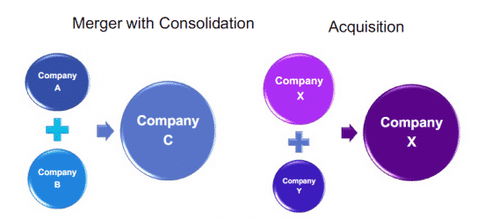
CORPORATE EXPANSIONS
*
Key Features:
-It involves purchasing of assets or stocks, merger or consolidation of another business.
-This strategy aims to enhance business growth, exploit market, acquire unique capabilities, transfer technology, synergize and diversify businesses.
-Mergers and acquisitions are two common types of corporate expansions.
*
5-13
Notes:
See Learning Goal 1: Compare the advantages and disadvantages of sole proprietorships.
This slide helps students understand why sole proprietorships account for the largest number of businesses in the United States.

Slide 14
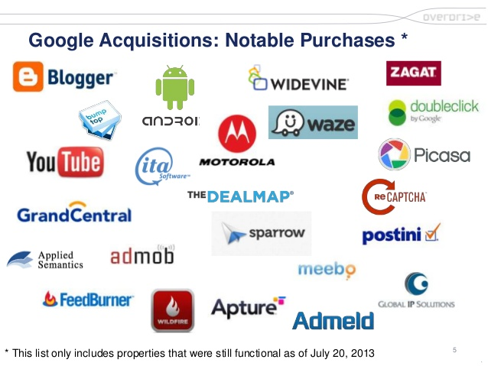
CORPORATE EXPANSION
*
Acquisition
One company’s purchasing of property and obligation of another company.
- The Target Company is the company that is being acquired.
- The Acquirer company is the company that is acquiring the target.
*
5-14
Notes:
See Learning Goal 1: Compare the advantages and disadvantages of sole proprietorships.
This slide helps students understand why sole proprietorships account for the largest number of businesses in the United States.

Slide 15

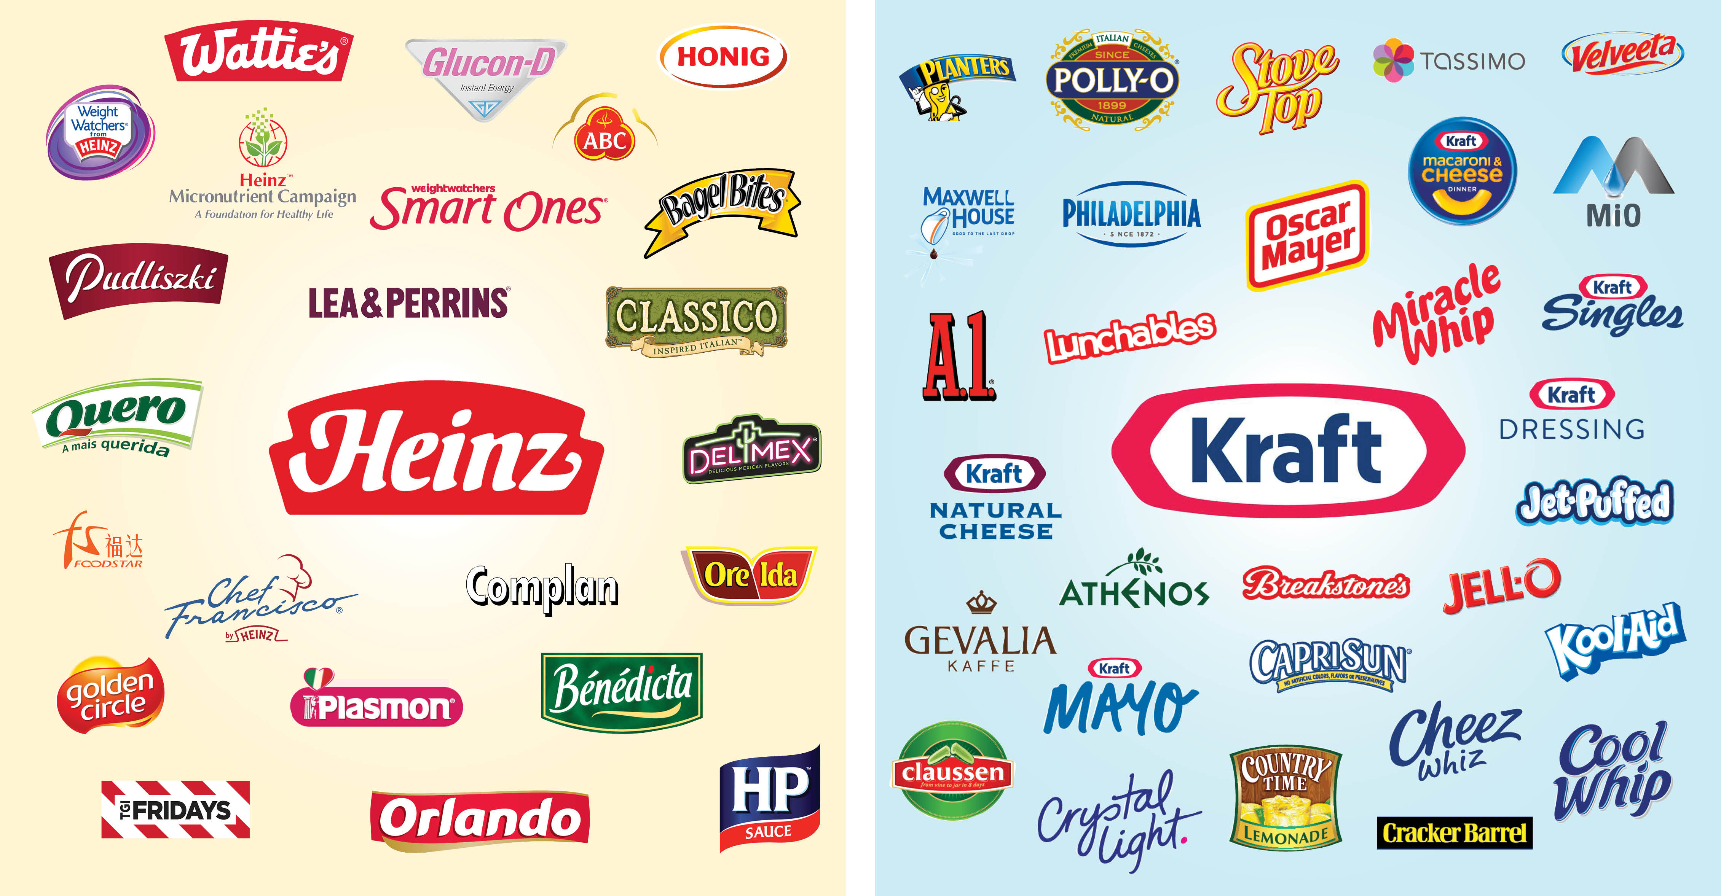
CORPORATE EXPANSION
*
Merger
The result of Two firms joining to form one company.
*
5-15
Notes:
See Learning Goal 1: Compare the advantages and disadvantages of sole proprietorships.
This slide helps students understand why sole proprietorships account for the largest number of businesses in the United States.

Slide 16
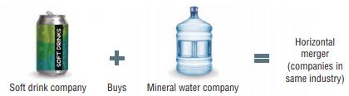
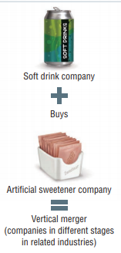
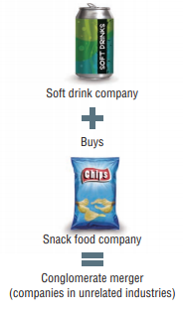
CORPORATE EXPANSION
*
Merger
Mergers can be divided into three types:
*
Vertical merger | Joins two firms in different stages of related businesses
Horizontal merger | Joins two firms in the same industry and allows them to diversify or expand their products.
Conglomerate merger | Unites firms in completely unrelated industries in order to diversify business operations and investments.
5-16
Notes:
See Learning Goal 1: Compare the advantages and disadvantages of sole proprietorships.
This slide helps students understand why sole proprietorships account for the largest number of businesses in the United States.

Slide 17
Individual Mini Activities
*
*
Give three (3) examples of mergers and three (3) examples of acquisitions.
Agree or disagree?
‘Formal rules, procedure and standards may slow down a corporation’s process’.
5-17
Notes:
See Learning Goal 1: Compare the advantages and disadvantages of sole proprietorships.
This slide helps students understand why sole proprietorships account for the largest number of businesses in the United States.

Slide 18
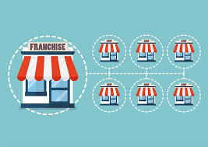
FRANCHISING
*
Key Features:
-It is an arrangement whereby someone with a good idea for a business (the franchisor) sells the rights to use the business name and to sell a product or service (the franchise) to others (the franchisee) in a given territory.
-It is a strategy to capture market share through a forming a big network of interdependent business relationships.
-It is a strategic alliance between groups of people who have specific relationships and responsibilities with a common goal to dominate markets, i.e., to get and keep more customers than their competitors.
*
5-18
Notes:
See Learning Goal 1: Compare the advantages and disadvantages of sole proprietorships.
This slide helps students understand why sole proprietorships account for the largest number of businesses in the United States.

Slide 19
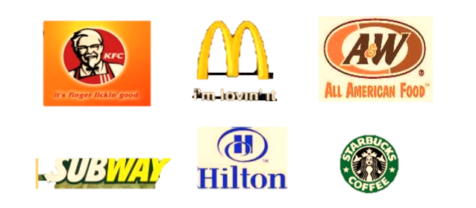


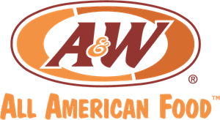


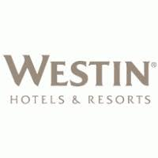
FRANCHISING
*
Popular examples:
*
5-19
Notes:
See Learning Goal 1: Compare the advantages and disadvantages of sole proprietorships.
This slide helps students understand why sole proprietorships account for the largest number of businesses in the United States.

Slide 20
FRANCHISING
*
*
Advantages | Disadvantages
Management & marketing assistance | Large startup costs
Personal ownership | Shared profit
Brand recognition | Management regulation
Financial advice & assistance | Coattail effects
Lower failure rate | Restrictions on selling
 | Fraudulent franchisors
5-20
Notes:
See Learning Goal 1: Compare the advantages and disadvantages of sole proprietorships.
This slide helps students understand why sole proprietorships account for the largest number of businesses in the United States.

Slide 21
Individual Mini Activities
*
*
1. Briefly describe the impact of COVID-19 on franchising of Bangladesh.
5-21
Notes:
See Learning Goal 1: Compare the advantages and disadvantages of sole proprietorships.
This slide helps students understand why sole proprietorships account for the largest number of businesses in the United States.

